Slide 1
Finding the Best Neighborhoods to Build Coffee Shops in Washington, DC
By: JD

Slide 2
Introduction
Great locations for coffee shops are locations where there is a shortage of coffee shops compared to the number of coffee drinkers in the area, and where the location can be accessible to the most people.
The Foursquare API can find coffee shop locations in DC and provide the number of check-ins at the coffee shop. This data will help us learn which areas have a high ratio of coffee shop customers to the number of coffee shops.
DC's data includes clusters of neighborhoods, which can serve a reference points. We can also incorporate Metro stop data from DC.. We can use this data to determine the degree to which the number of Metro stops in a given area correlates with the number of coffee shops in the same area.

Slide 3
Data and Methodology
Acquire and clean DC neighborhood geo data
Acquire and clean DC Metro stops geo data
Generate the number of Metro stops per area unit of each neighborhood
Query the Foursquare API for coffee shops in each neighborhood
Locate the neighborhoods that were in the vicinity of the coffee shops
Determine which neighborhoods had the highest number of cofee shops per area unit
Assess the correlation between Metro stops and coffee shops in each neighborhood

Slide 4

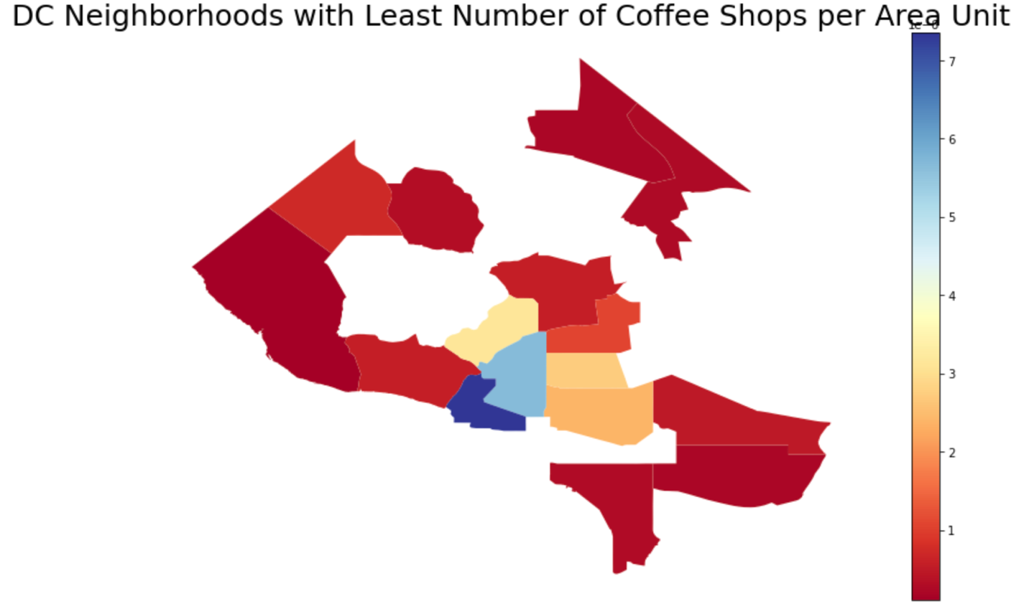
Results

Slide 5
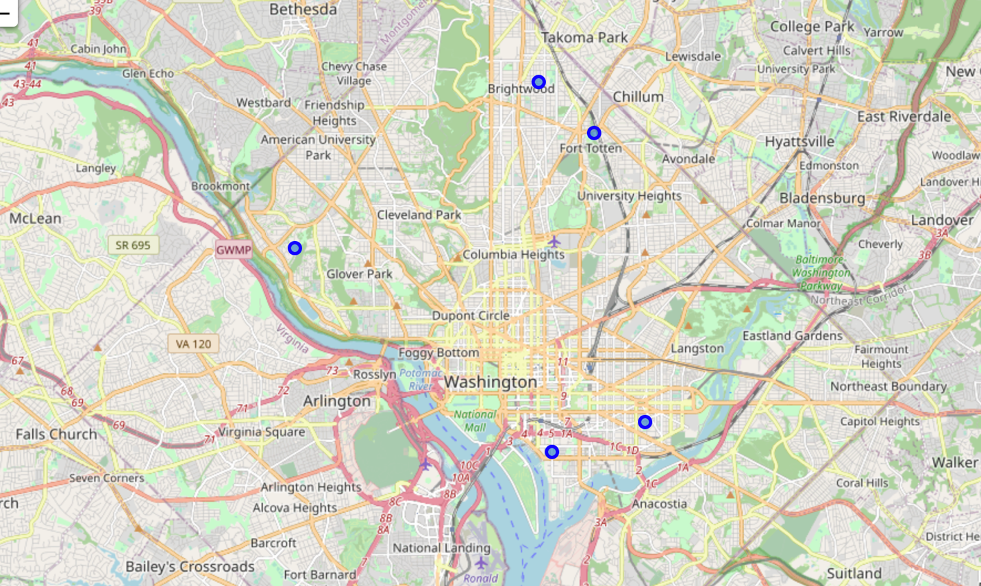
Results
The five neighborhoods with the lowest number of coffee shops per area unit

Slide 6
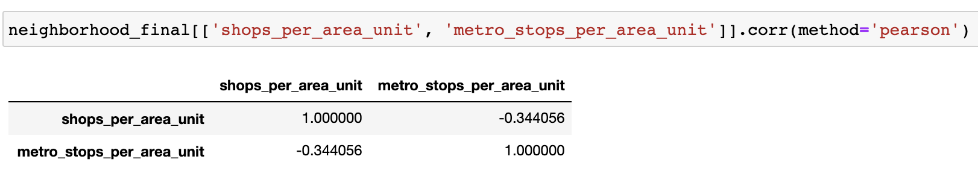
Results
Pearson correlation between the number of coffee shops per area unit and the number of Metro stops per area unit:
Slightly fewer coffee shops in areas that have greater Metro access.
Opportunity:
Build closer to Metro stop where there is higher foot traffic.

Slide 7
Conclusion
Recap:
Acquired DC neighborhood geo data
Acquired DC metro stops geo data
Generated the number of metro stops per area unit of each neighborhood
Queried the Foursquare API for coffee shops in each neighborhood
Located which neighborhoods the coffee shops were in the vicinity of
Determined which neighborhoods had the highest number of coffee shops per area unit
Assessed the correlation between metro stops and coffee shops

Slide 8
Conclusion
Further research:
Calculate the number of checkins at all coffee shops in each neighborhood
Calculate the number of checkins divided by the number of coffee shops divided by area unit
The neighborhoods with the highest values in Step 9, would be the best locations
We can provide a final assessment of those locations by analyzing the locations based on whether there is a strong correlation between the number of Metro stops in an area and factoring in the strengths and weaknesses of our data

